Slide 1
DEVELOP AN OUTCOME L2
Evidence of Learning Template
185281
Project Title 2048 game
Jason Li

Slide 2
Github /Drive link
https://docs.google.com/presentation/d/1JDQsLIbhMu4dg0GG2dJWWoE95LKKZ5VaQ7bYfUr8q98/edit?usp=sharing
Trello board or PM link
You MUST provide evidence showing how the problem has been decomposed, how the components have been developed and trialled, and of how they have been assembled and tested to create a final, working outcome.

Slide 3
Project management: Setup
Record evidence that you have setup project management tools to manage the development of your outcome.
I used plain text files on Google as my planning sheet .
Add screenshot
Record evidence that you have chosen project management techniques to manage the development of your outcome.
collaboration/sharing - G Docs
Feedback or evaluation
Online syncing
Record evidence that you have setup/ chosen version control tools/techniques to manage the development of your outcome.
Explain why you believe that these tools and techniques are appropriate for the development of your outcome.

Slide 4
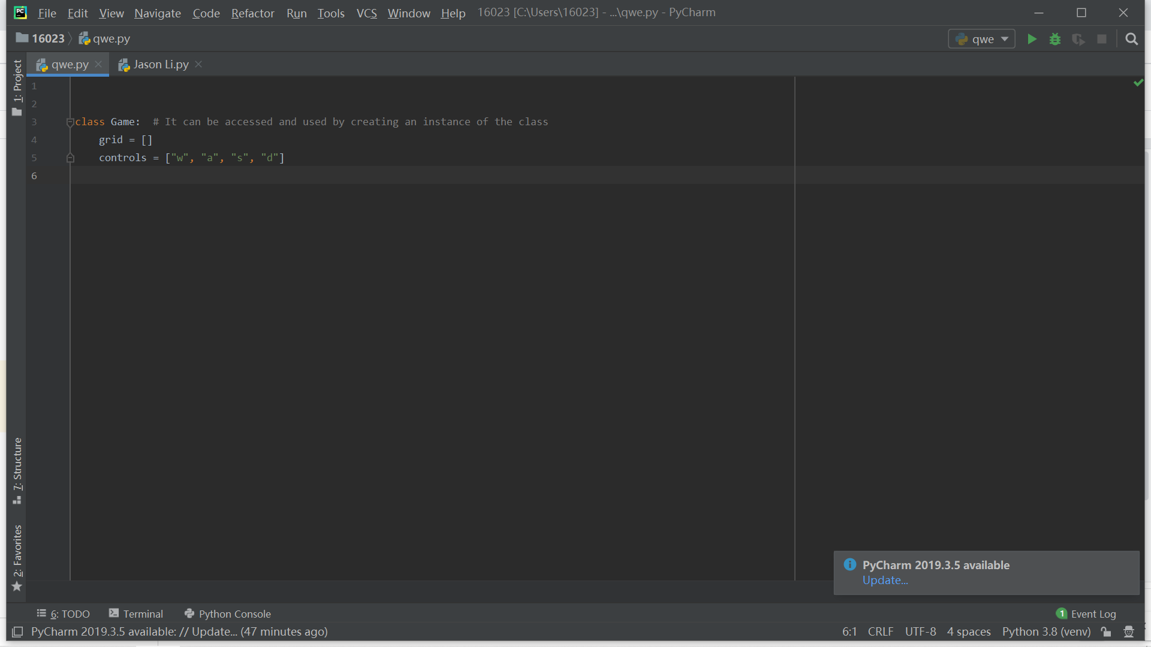
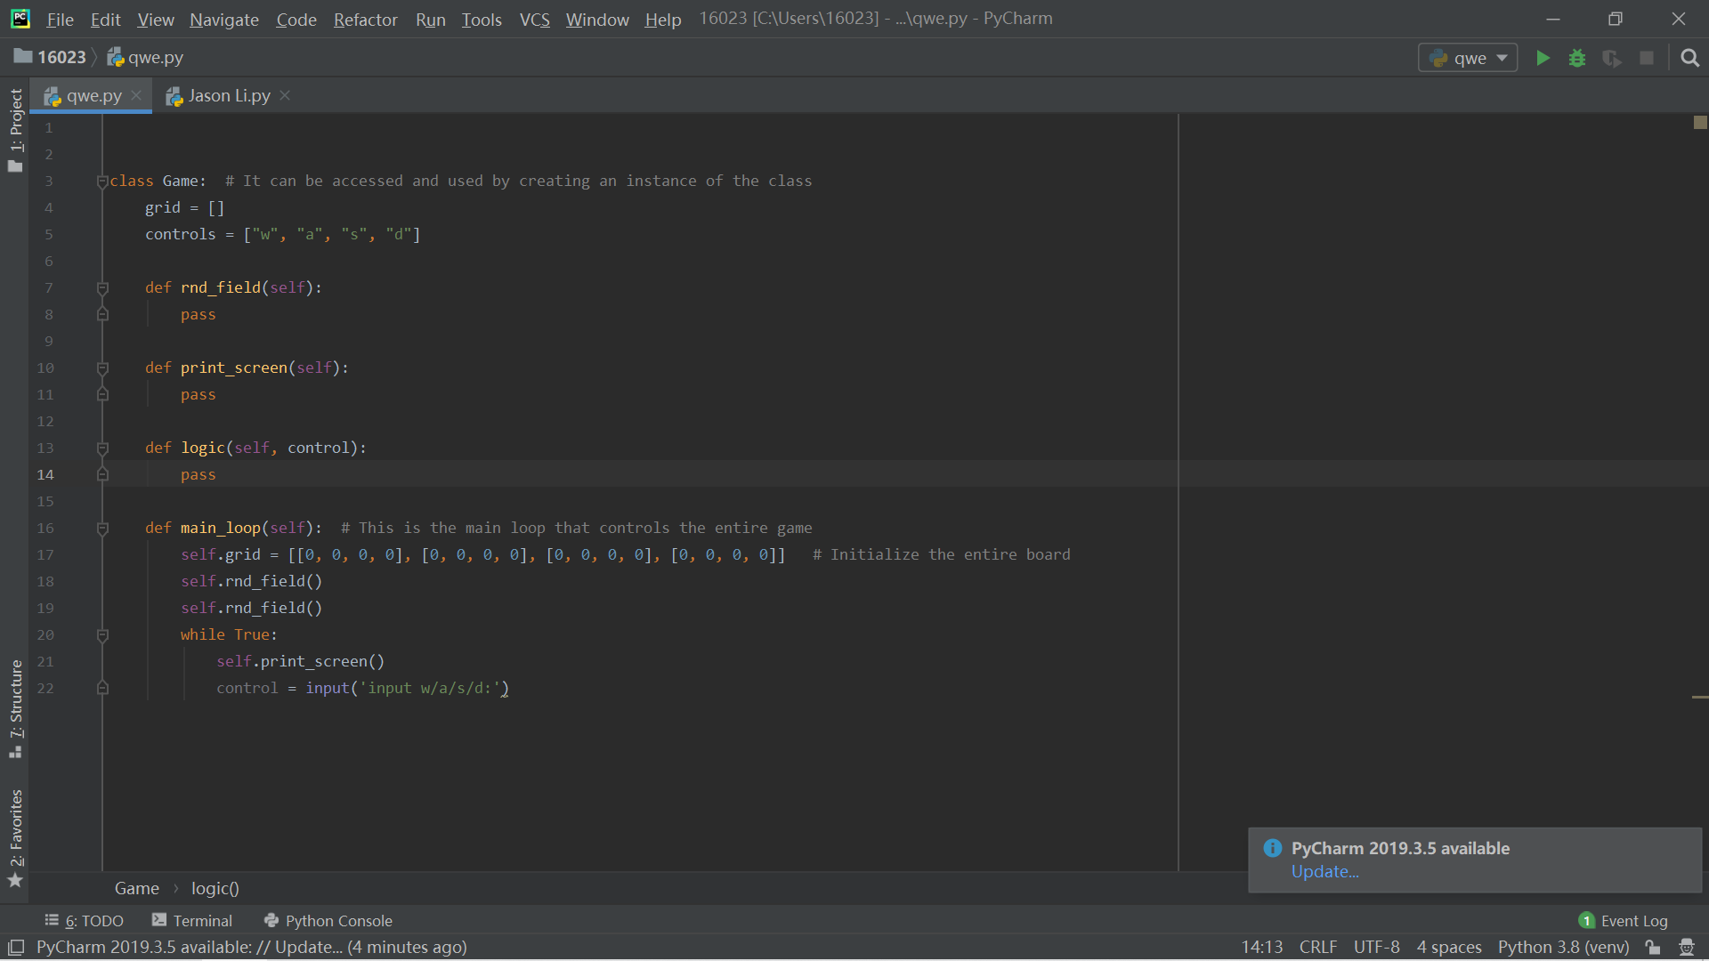
Setup
1. I first made the code for the direction control keys
2. I made the grid (4x4)

Slide 5
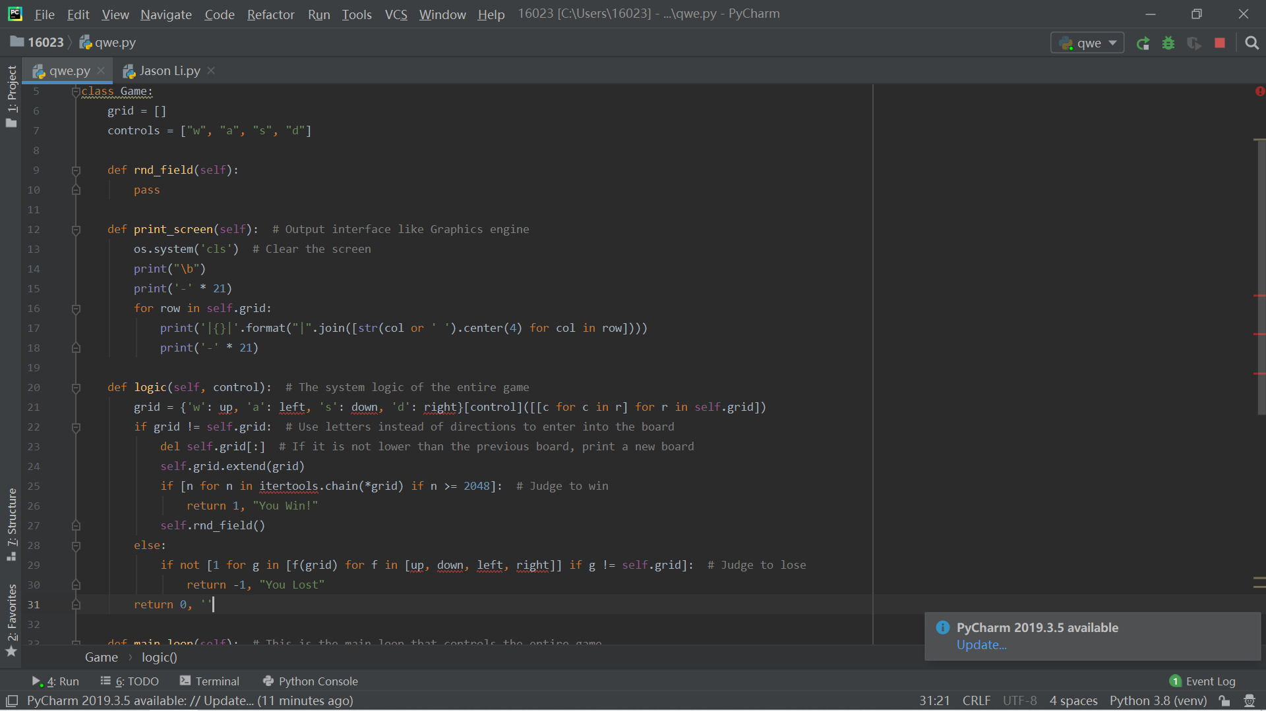
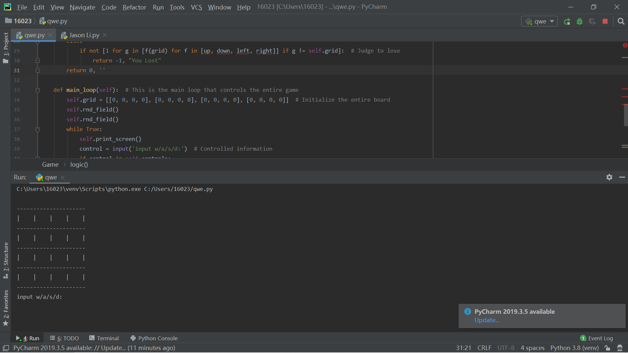
Setup
3. I use code to make numbers appear in the spaces
4. I made a cycle for this project, and made a start code.

Slide 6
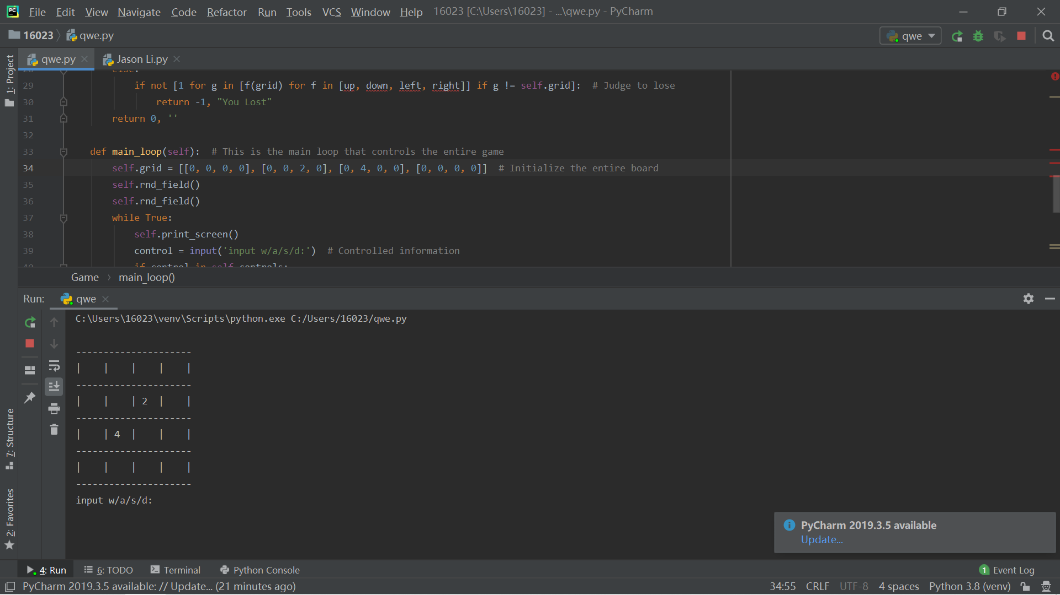
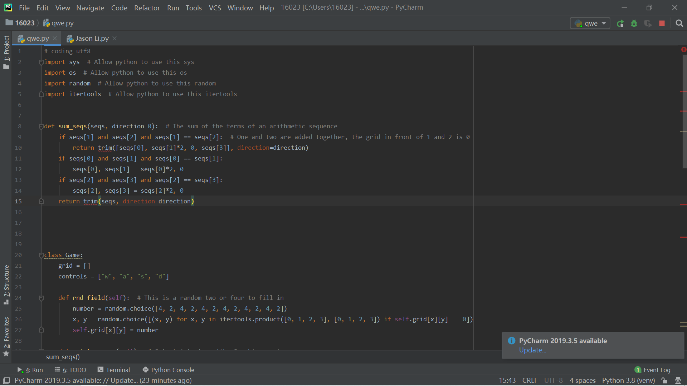
Setup
5. I changed the number in this grid to only 2 random numbers at the beginning（2 and 4）
6. Then I made a code to add same two even numbers to get an average code

Slide 7
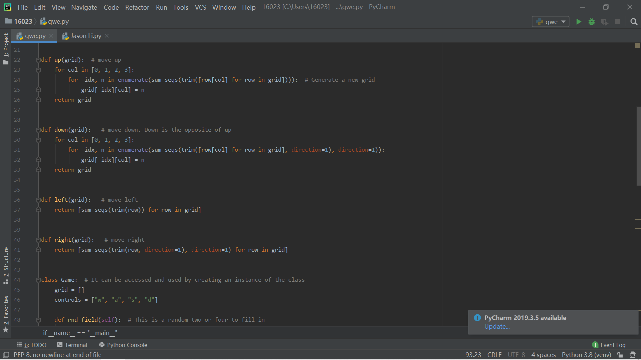
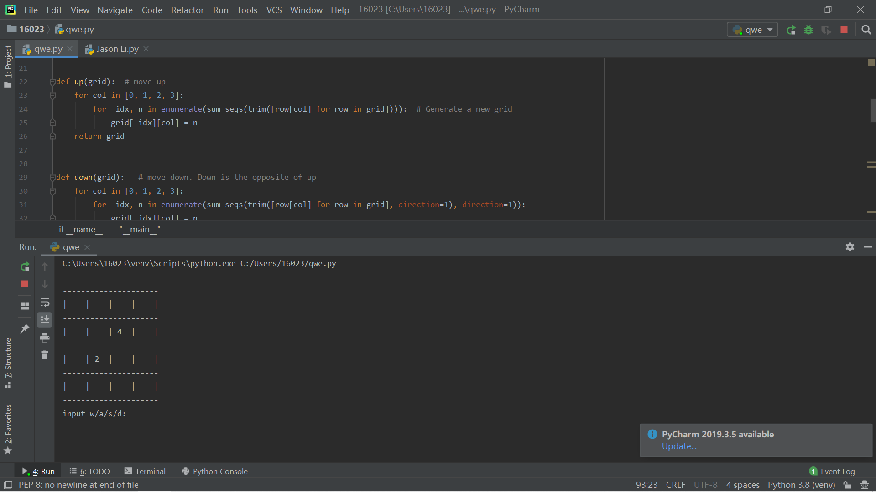

Setup
7. I changed their control to, if pressed, the entire grid will move down
8. If you walk in any direction, an even number may appear randomly in the empty grid.

Slide 8
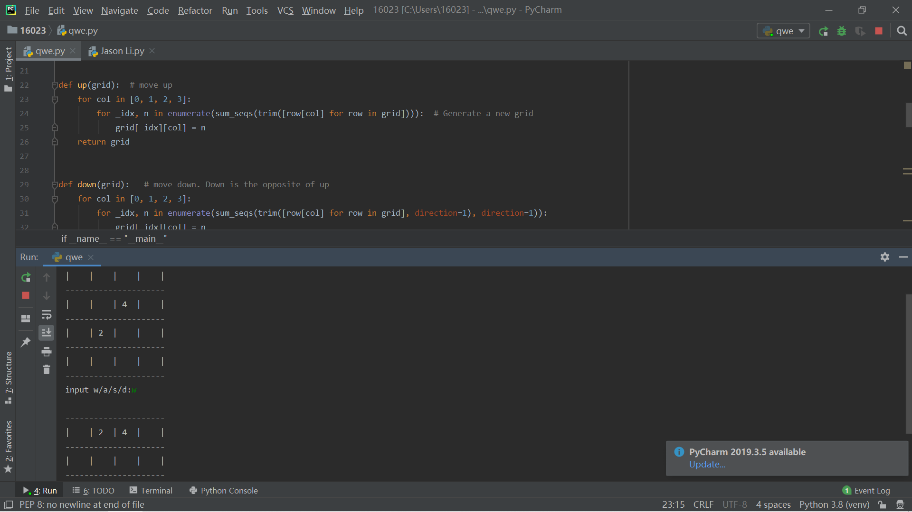

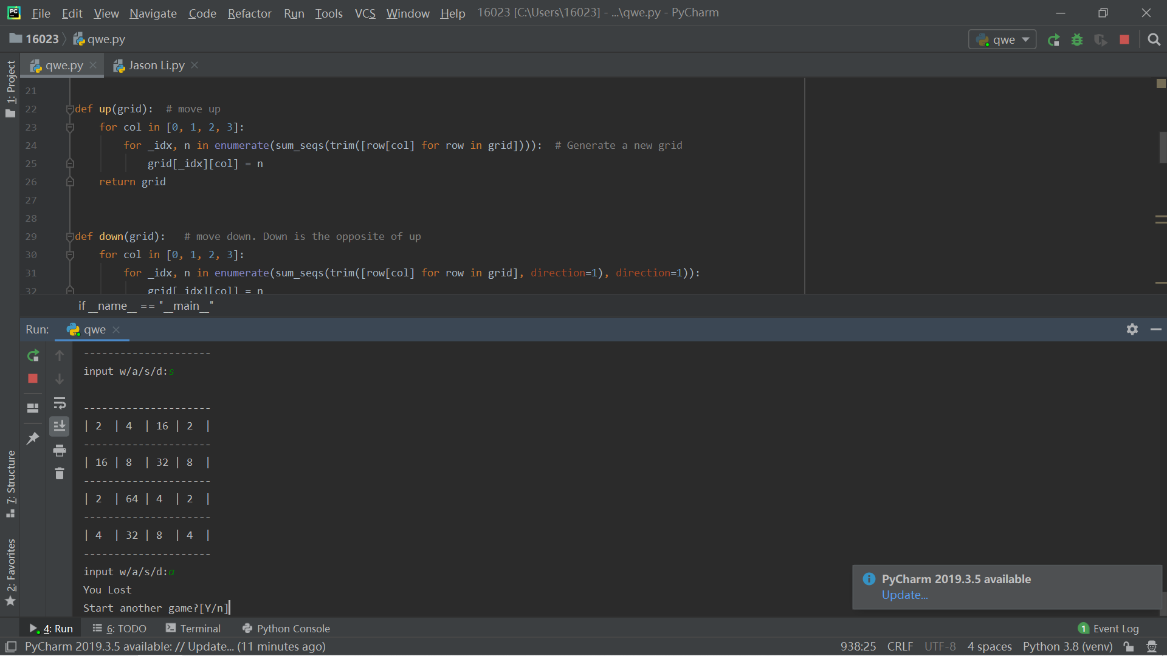
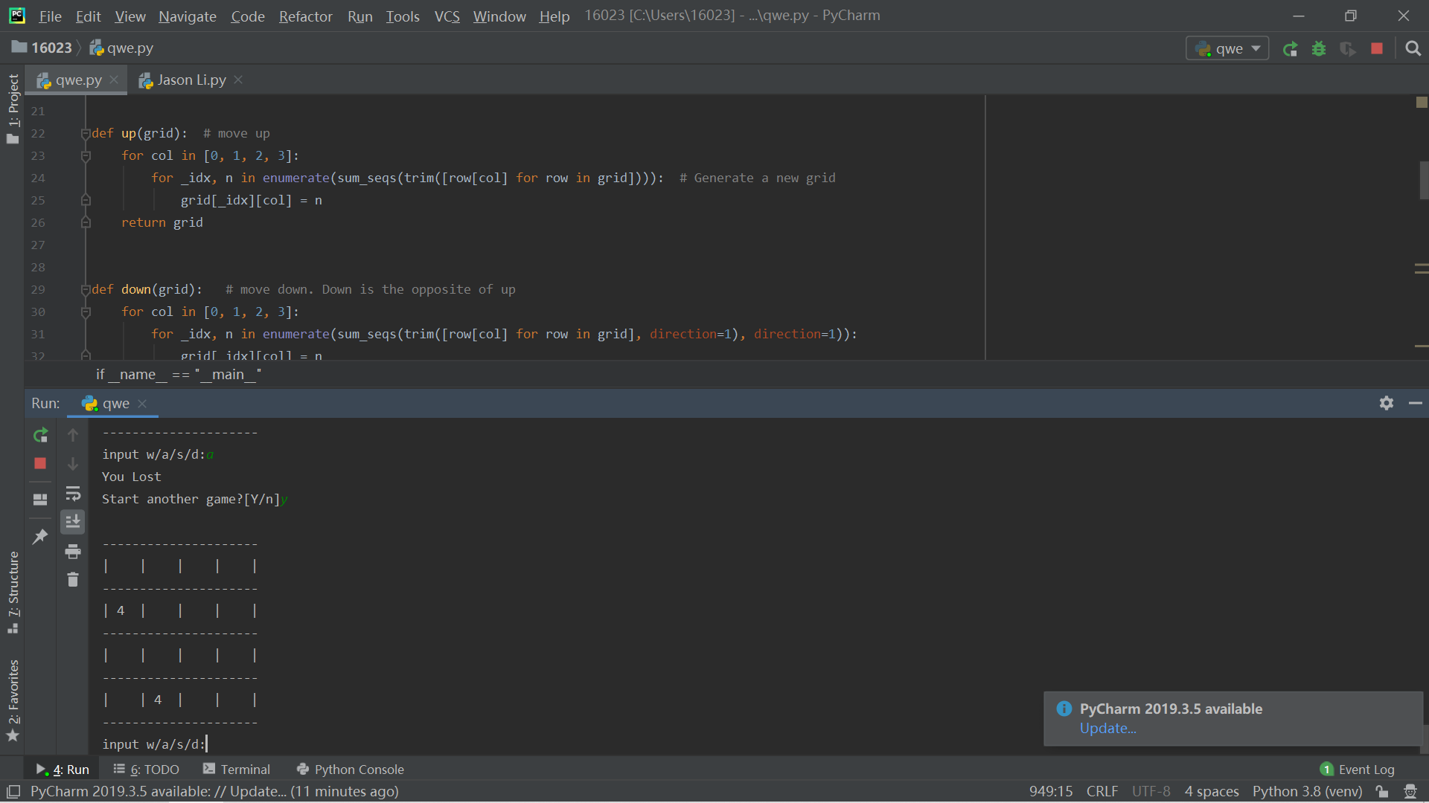
Setup
8. If you walk in any direction, an even number may appear randomly in the empty grid.
9. Finally, if the grid is full and cannot be moved and cannot be added, I made a code to let them end the game, which is also a game loop.（ Like if you win ,you can choose start a new game or finish）

Slide 9
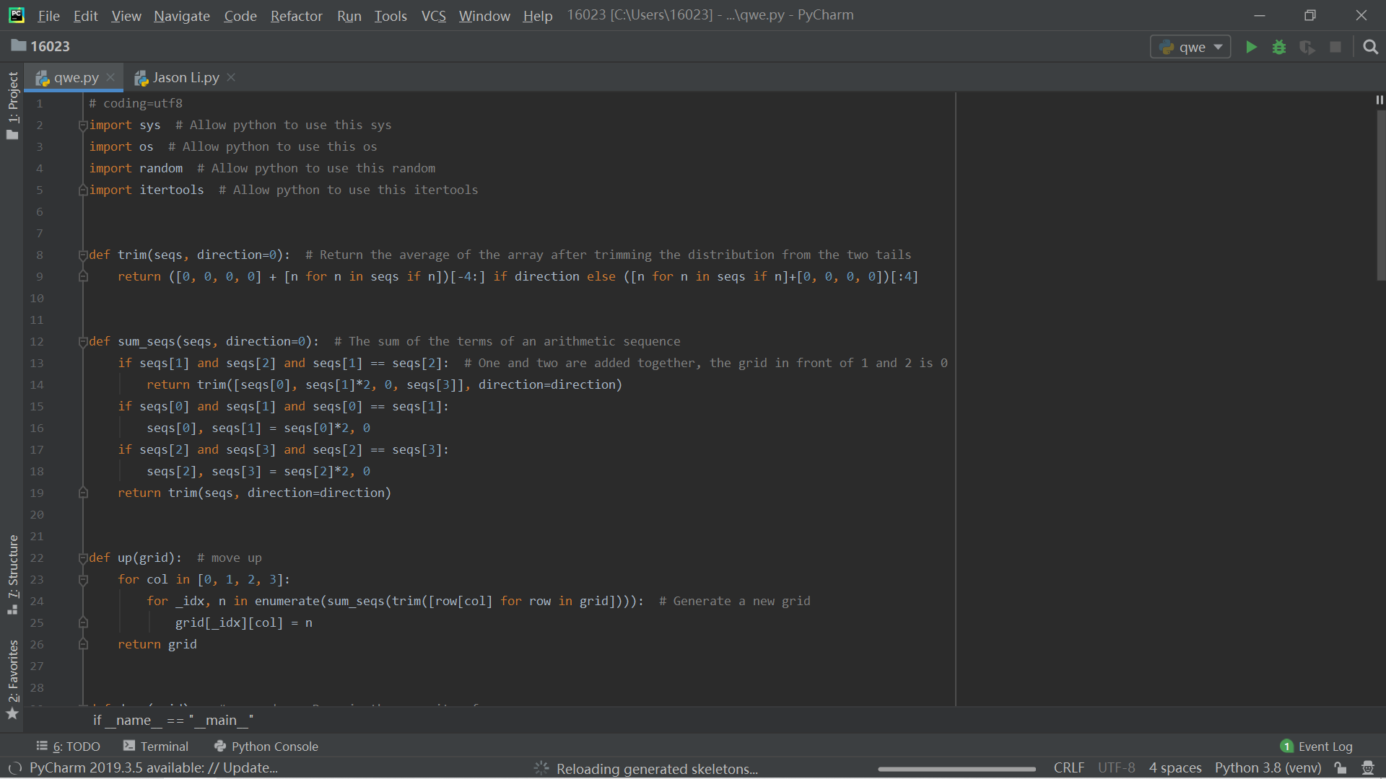
Setup
Record evidence that you have chosen project management techniques to manage the development of your outcome.
Import: Importing refers to allowing a Python file or a Python module to access the script from another Python file or module.
Def: Definition
Def trim : Calculate the average
Def sum_seps : The Python sum() function adds up all the numerical values in an iterable

Slide 10
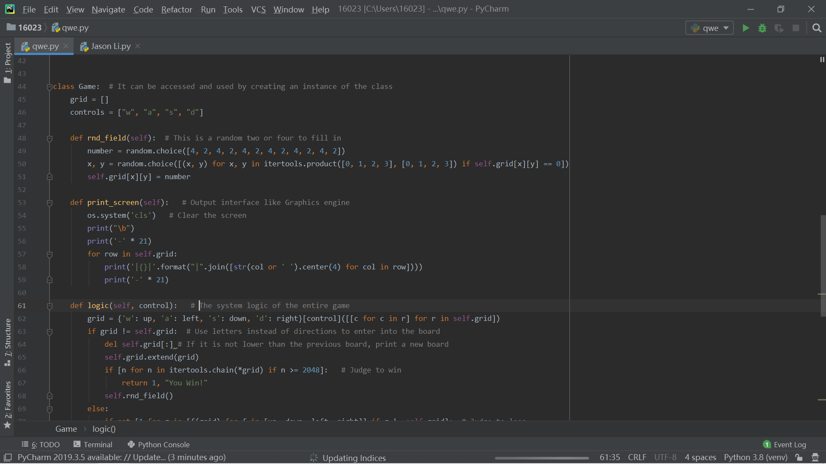
Setup
class: An object is created using the constructor of the class. This object will then be called the instance of the class.
print: The print() function prints the specified message to the screen, or other standard output device.
if and else: An if else Python statement evaluates whether an expression is true or false.
self : self represents the instance of the class
grid : The Grid geometry manager puts the widgets in a 2-dimensional table. T

Slide 11
Setup
Record evidence that you have setup/ chosen version control tools/techniques to manage the development of your outcome.
I have used pycharm to manually set up my version control and saved all my versions to a file.Whenever I complete a part of the code, I will save it. The advantage of this is that I can back up my work, so I can track my work.

Slide 12
Setup
Explain why you believe that these tools and techniques are appropriate for the development of your outcome.
These tools and techniques are conducive to making this 2048 mini game, because these techniques can make grids and control keys, add up to the average, etc.
The tools are helpful to help you complete the corresponding tasks every day, and then complete the project on time

Slide 13
Decomposing outcome
Record evidence that you have broken the outcome into smaller components.
I have broken down my project into small pieces so that I can better manage my work. I have broken down my project into: Control key, gird(display), Random numbers appear in the grid，gird(set up), player input, The circulation of the whole system. I only spent 1 hour on each part, there is nothing too complicated to understand. The most is that I spent 2 hours in the system logic loop. Because this part is difficult, I have to find information from the Internet how to solve the problem of infinite loop. Add two even numbers to form a new number. It also took me an hour and a half, because in addition to controlling their direction, I also control the changes of the entire board

Slide 14
Decomposing outcome
Control key
gird(display)
Random numbers appear in the grid
The whole system is running
Player input
Gird(set up)

Slide 15
Trialling components
Record evidence that you have trialled components. Show that you gathered information to inform your decision making.
Record evidence that you have trialled multiple components and have selected those most suitable.
Record evidence that you have used information from trialling appropriately to improve the functionality of the outcome.

Slide 16
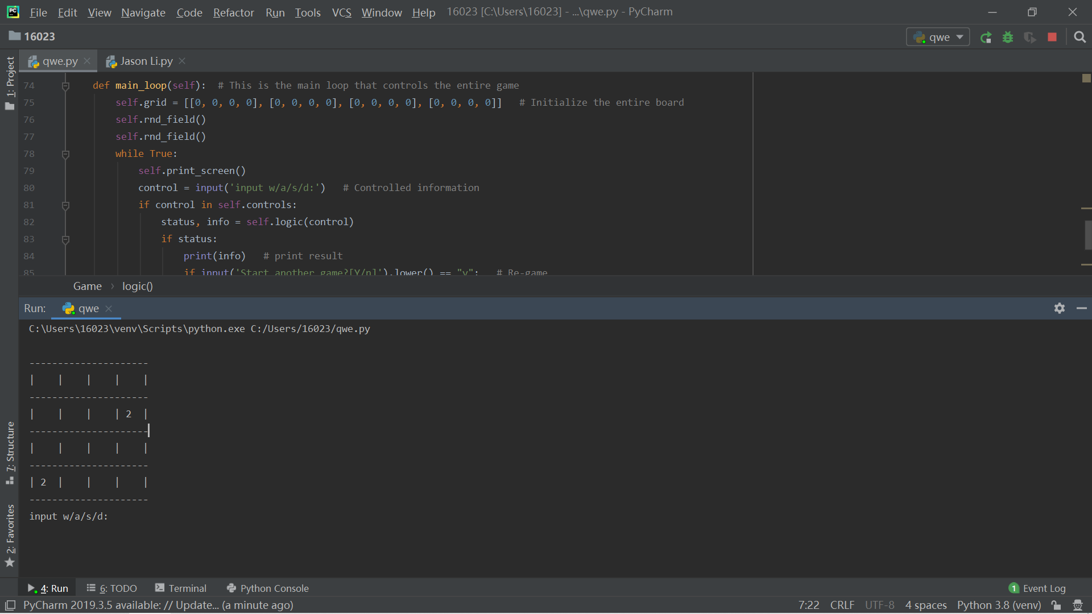
Record evidence that you have trialled components. Show that you gathered information to inform your decision making.
I have tracked the form image. Previously, I used the image function to stack all the numbers on one line without separating them. The advantage of this feature is that I can make my work look more comfortable and simpler.
I used [ [ ] ] to complete my grid

Slide 17
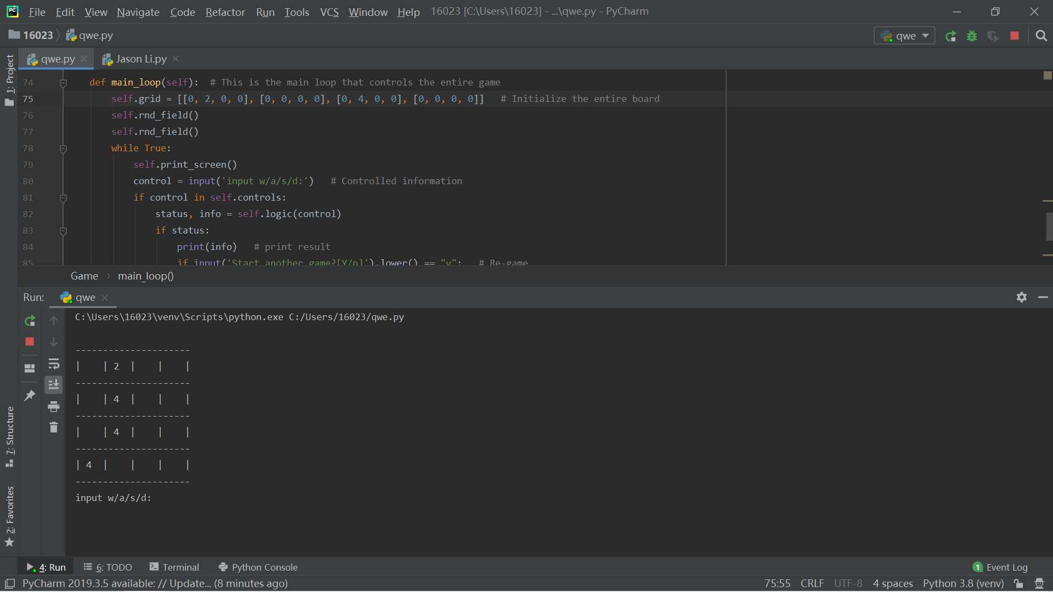

Record evidence that you have trialled multiple components and have selected those most suitable.
The picture above is before the trial, and the picture below is after the trial. I randomly input 2 or 4 in the back of grid, it will be displayed on the form and I added in the code every time the production form will produce two even numbers. And once I changed the two numbers in that line of code, the table will show 4 even numbers when it is generated.

Slide 18
Record evidence that you have used information from trialling appropriately to improve the functionality of the outcome.
Generally speaking, this game generates only two random even numbers at the beginning, so I changed the entire chart production setting to two random number generation, which also allows players to have a better gaming experience because it will increase the difficulty for players It feels challenging. At the same time, this will also increase the game's durability and logic

Slide 19
Testing outcome
Record evidence that you have tested your outcome.
Explain how the testing made sure your outcome functions as intended to meet its purpose and requirements.
Record evidence that you have used information from testing appropriately to improve the functionality of the outcome.

Slide 20
Record evidence that you have tested your outcome.
I have tested the results of my operation and it can be run. One is to end up generating a new chart, the other is to recreate a chart for players to continue playing

Slide 21
Explain how the testing made sure your outcome functions as intended to meet its purpose and requirements.
I have tested it many times, and every time I reach the result very successfully. For example, if 2048 is successfully completed and there is no moving space to go, two options will pop up, one is to renew and the other is to end. The purpose of creating this game is to develop thinking skills for children aged 5-10.

Slide 22
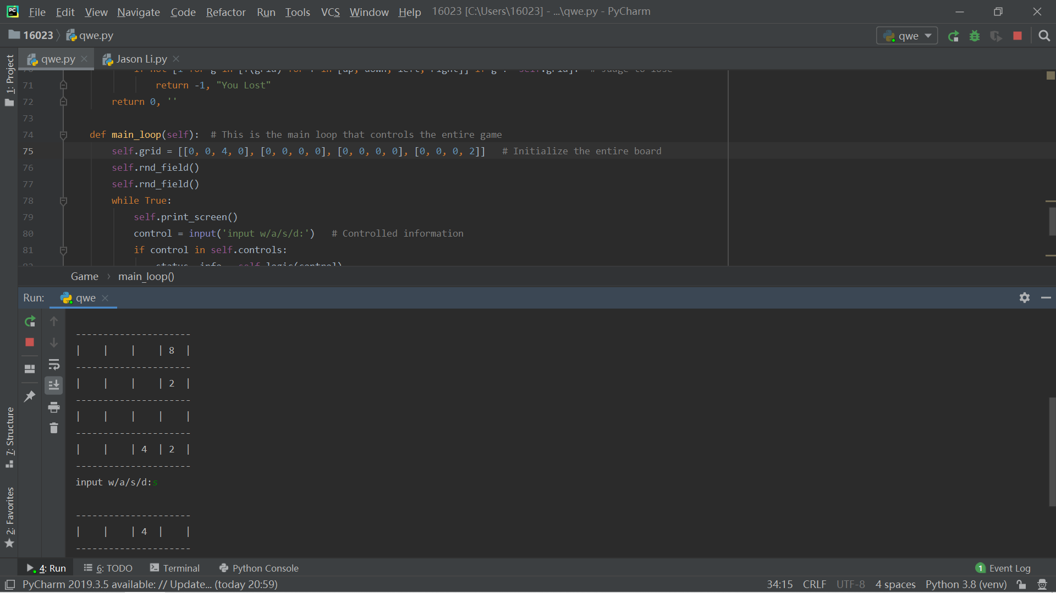

Record evidence that you have used information from testing appropriately to improve the functionality of the outcome.
I use the information in the test (such as winning conditions) to make sure that my game is running properly, and test my results after completion to make sure that every part of the game is running properly. When I was working on this game before, I had a big problem, which is mobile. If I move my table, it will only move one row, not the entire table. Later, I went online to find out how to move the entire table by pressing the arrow keys. It took me about two hours to learn this code. As a result, I also solved this problem so that my code and game can run normally.

Slide 23
Project management: Applied
Record evidence that you have used your project management tools to manage the development of your outcome.
Record evidence that you have used your project management techniques to manage the development of your outcome.
Record evidence that you have used version control tools to manage the development of your outcome.

Slide 24
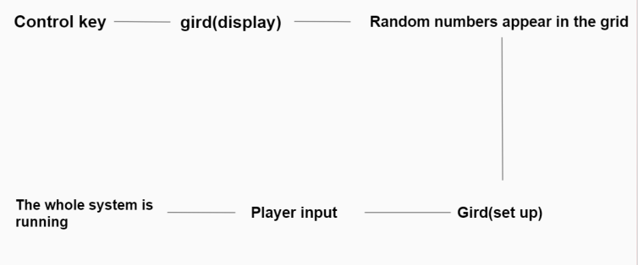
Record evidence that you have used your project management tools to manage the development of your outcome.
I did not use pycharm and monday.com as my project management tools to manage game settings. But I have the idea to follow the steps to complete my game.

Slide 25
Record evidence that you have used your project management techniques to manage the development of your outcome.
I shared my code and the code after it was run to my friends, and asked them to give me a little feedback and transformation of the code.
The feedback my friend gave me is: change the interval of grid, or make some gap between the two numbers or use this |

Slide 26
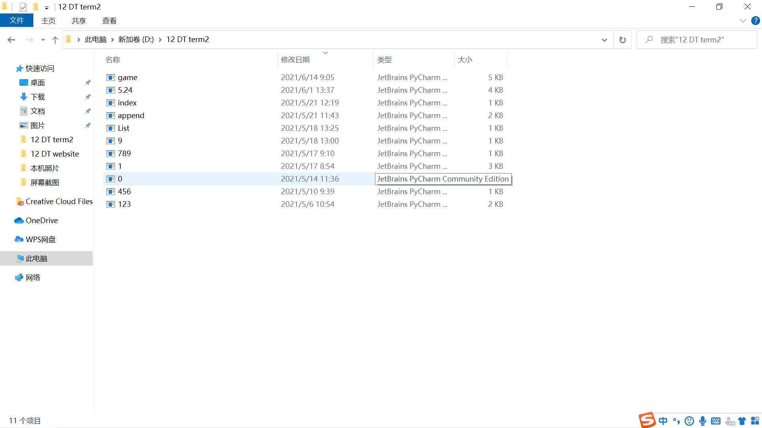
Record evidence that you have used version control tools to manage the development of your outcome.
I have made a file for my version in my computer, and also manually set different tabs in pycharm to record each new version of me. When I make a code, I will use a new python to save it in this file, and mark the time and content.

Slide 27
Version Control
Your version control evidence should go here. This could be in the form of annotated screenshots which show you you managed this process or you could make a brief screencast explaining how you implemented version control.
I use pycharm to control my version. Every time I add a new feature, I create a new tab in pycharm

Slide 28
Relevant Implications
Explain the relevant implications here. Please watch this video to learn how to do this.
Explain the Implications that are relevant to your outcome.
Record evidence that you have addressed the Implications that are relevant to your outcome.

Slide 29
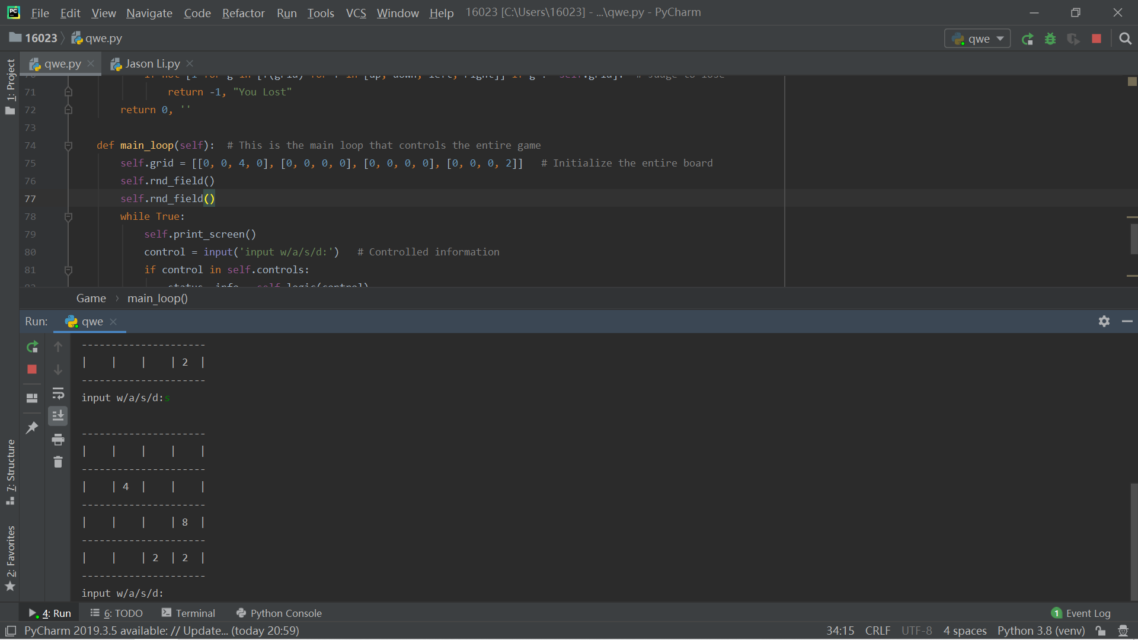
Relevant Implications： user
My target users are people who are interested in board games, as well as children aged 5-12, suitable for children to learn math addition and subtraction. Because adults tend to like more complicated games, such as chess, while children like simpler things and can learn a lot of knowledge. Game overview, each player only needs to move and calculate the position to pass the level.

Slide 30
Relevant Implications: Legal
This game is 100% legal. This game is not copied from any copyrighted source, and there is no illegal or offensive copy of anyone's work. Players can play the game with peace of mind and will not be punished by law.

Slide 31
Relevant Implications： usability
The control of this game only needs to move the mouse to enter the position, and then you can move the position of the grid when you enter the direction key. This is a super simple control.

Slide 32
Relevant Implications： future
I will add more new features to the game in the future, such as restart function, change background function and so on.

Slide 33
Evaluate
Discuss how the information from planning, testing and trialling of components assisted in the development of a high-quality outcome.
I used my ideas to make this game. Although there are a lot of troubles, for example, I have to think and sometimes forget certain things. But it doesn't matter, I will use documents to plan my ideas, and I will start programming until I finish planning. I made different tabs and pycharm will automatically save them to my local file. I can also name the tabs, so I know the contents of each version and can save it.
Component testing and trial-I have tested my game many times. I know how many problems I need to fix and improve. If there is no trial, I will not complete the work. Small things such as the board and basic math can have a huge impact on the game. For example, his average code. It took me two hours to understand and use this code. Finally, I also successfully used the average of the sum of my two even numbers.

